Slide 1
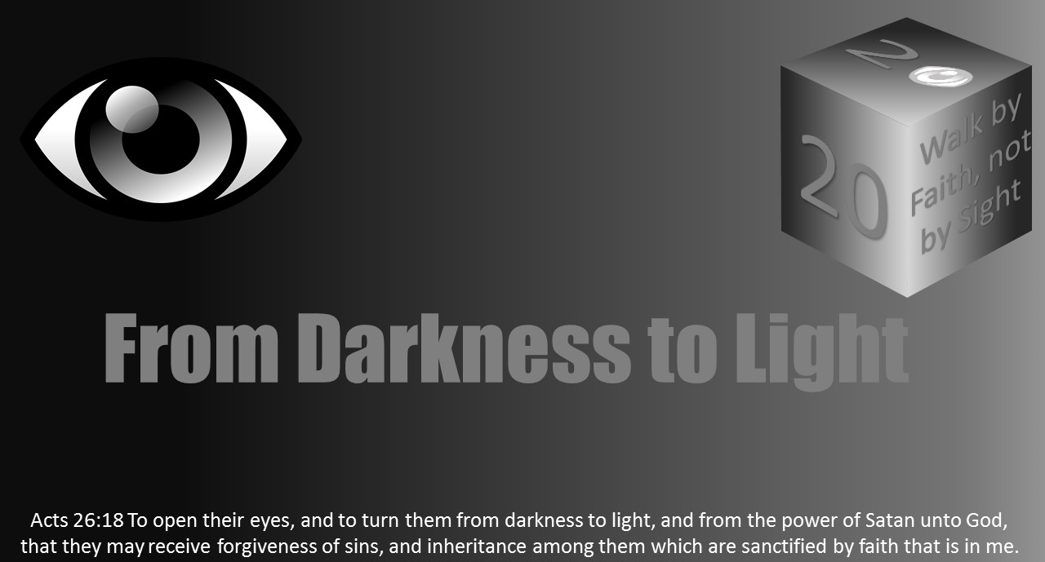


Slide 2
Darkness Lesson 5 Next Sunday IS Eye Plucking day!

Slide 3


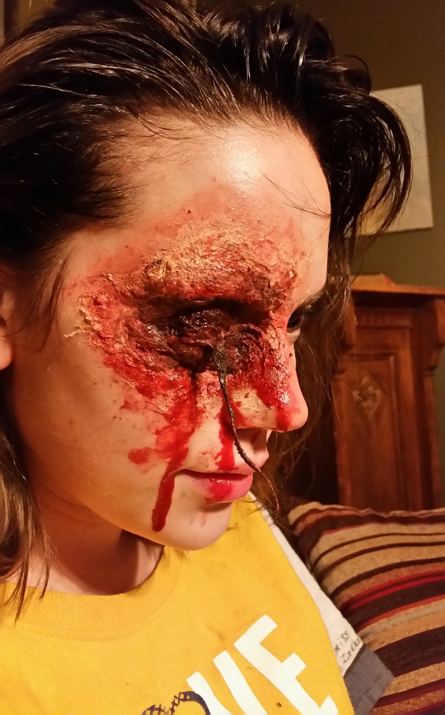
introduction
Imagine it. “Those participating in eye plucking this Sunday please move to the front pews on the right.”
“Eye plucking Sunday” might be so gruesome that it might draw a special crowd. T
here might be objection picketing outside at the street too.
It might be quite the circus. Who would knowingly pluck out their eye?
(Photo: Make-up artist DeGarmo’s impression of eye plucking).

Slide 4
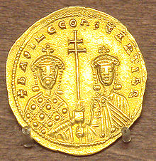
Historical example
In 1014 about four years before Bulgaria would finally surrender at the Battle on Kleidion, Basil II would take a decisive win over his long-time war with Samuel of Bulgaria.
Samuel escaped because of the valor of his son Gabriel.
However, bail would capture 15000 Bulgarians.
After this victory, he committed a cruelty that would fire Bulgaria’s resistance until the end of the war.
He blinded 99 out of 100 captured soldiers, leaving one man with only one eye to lead the other 99 home to Bulgaria in groups of 100.
TWo days later, upon learning of the events, Samuel would die of an apparent stroke.
Notes:
In history, perhaps one of the best-known cases of plucking eyes was in 1014. Byzantine emperor, Basil II, was born into a world of politics and suspicious deaths among powerful people and family members. He would rule from 976-1025. He often was called Basil the young and later Basil Porphyrogennetos (Basil the Purple born). After the final subjugation of Bulgaria, the empire’s strongest European foe, he was also known as the Bulgar Slyer. He would leave the empire in military security and strong economic status, in essence, the zenith of the empire. (Photo Wikipedia Basil II with Constantine VIII )
In 1014 about four years before Bulgaria would finally surrender, at the Battle of Kleidion, Basil II would take a decisive win over his long-time war with Samuel of Bulgaria. Samuel escaped because of the valor of his son Gabriel. However, Basil would capture 15,000 Bulgarians. He carried memories of his defeats including a significant loss 28 years earlier. At this victory, he committed a cruelty that would fire Bulgaria's resistance until the end of the war. He blinded 99 out of 100 captured soldiers, leaving one man with only one eye to lead the other 99 home to Bulgaria in groups of 100. Two days later, learning of the events, Samuel would die of an apparent stroke. Beyond this historical example, there are scriptural cases.

Slide 5
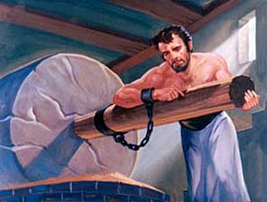
Scriptural Examples
Perhaps the best-known example is when the Philistines gouged out Samson’s eyes after his capture in Judges 16:21

Slide 6
Scriptural Examples
King Zedekiah experienced the same fate after his capture by the Chaldeans.
Jeremiah foretold that King Zedekiah would not die by the sword (Jer 34:45). ‘
Ezekiel prophesied King Zedekiah would be snared by the chaldeans, brought to babyklon, but would not physically see it (Ezek 12:13)
Prophesy was fulfilled when the Chaldeans gouged King Zedekiah’s eyes after witnessing the death of his sons before taken to Babylon (2 Kings 25:7 and Jer 39.6-7).

Slide 7
Scriptural example
In 1 Samuel 11, Nahash the Ammonite offers peace to the people of
Jabesh-gilead if they agreed to put out the right eye of every man in the
city, bringing disgrace to Israel. The elders of Jabesh negotiated time to
see if they could be rescued by sending out messengers before giving
themselves to Nahash. Saul received their message and sent out the
call to Israel. The Ammonites were defeated, and the nation was
renewed with Saul as king.

Slide 8

Plucking out an eye
Matthew 5:29-30 (ESV) reads: “If your right eye causes you to sin, tear it out and throw it away. For it is better that you lose one of your members than that your whole body be thrown into hell. And if your right hand causes you to sin, cut it off and throw it away. For it is better that you lose one of your members than that your whole body go into hell.”

Slide 9
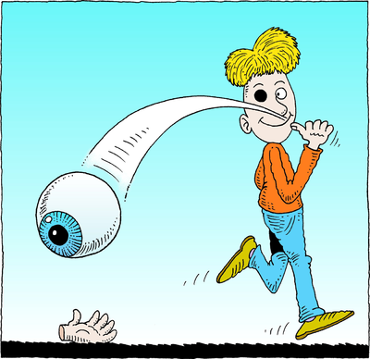
Plucking out an eye
Some might see this as a literal instruction, but most understand it as a hyperbole.
Christ is asking us to recognize the value of eternal things, and not to be derailed by the physical and temporal distractions the devil places in front of our eyes.
In other words, at all cost get untangled from sin because eternity is so much more important than the most valuable things in this life, even an eye or a hand.

Slide 10
Out of the heart
Sin starts in the mind/heart as we learn in James 1:14.
It is not the seeing, but the further building and focusing on what one sees toward sin.
The text of Matthew 5:29-30 is a hyperbole because the removal of an eye, hand, or foot does not change the condition of the heart. T
he person with one eye and one arm and one foot can still sin. We are meant to understand that being eternal with God makes all earthly desires seem trivial.

Slide 11
Out of the heart
Christians cannot allow sin to be an integral part of their lives.
We must seek to overcome sin, even if that causes a loss as painful as the loss of an eye or hand. Salvation is far more precious.
Romans 6:11-14 encourages Christians: “Likewise reckon ye also yourselves to be dead indeed unto sin, but alive unto God through Jesus Christ our Lord. Let not sin therefore reign in your mortal body, that ye should obey it in the lusts thereof. Neither yield ye your members as instruments of unrighteousness unto sin: but yield yourselves unto God, as those that are alive from the dead, and your members as instruments of righteousness unto God. For sin shall not have dominion over you: for ye are not under the law, but under grace.”

Slide 12
Out of the heart
In Mark 7:18-23, Jesus explains it is what comes out of the heart that is evil: “And he saith unto them, Are ye so without understanding also? Do ye not perceive, that whatsoever thing from without entereth into the man, it cannot defile him; Because it entereth not into his heart, but into the belly, and goeth out into the draught, purging all meats? And he said, That which cometh out of the man, that defileth the man. For from within, out of the heart of men, proceed evil thoughts, adulteries, fornications, murders, Thefts, covetousness, wickedness, deceit, lasciviousness, an evil eye, blasphemy, pride, foolishness: All these evil things come from within, and defile the man.”

Slide 13
A Pattern of the Sinful and the Children of Light
Psalm 1:1-2 teaches, “Blessed is the man that walketh not in the counsel of the ungodly, nor standeth in the way of sinners, nor sitteth in the seat of the scornful. But his delight is in the law of the LORD; and in his law doth he meditate day and night.”
This text has the progression of the sinful and corrective actions to take for the children of Light. The sinner starts by walking by the activity of the ungodly. Maybe this is accident exposure followed by a bit of rubbernecking.
Then, the person is standing nearby to the activities; Not exactly fully involved but soaking it up by their presence.
But in the end, the person is fully involved by sitting among the sinners.
A person might not prevent a bird from flying over their head, but they do not have to allow it to nest on their head.
Similarly, we do not have to let sin take place and root. In contrast to the pattern of the sinful, the instruction for the child of God is to delight and meditate on God’s law.

Slide 14
A Pattern of the Sinful and the Children of Light
Christians should not focus on the flesh but on Christ.
We must train ourselves to refocus on God by study, meditation, and prayer.
2 Timothy 2:15-16 is often cited as the first part of a diligent training plan.
The Bereans in Acts 7:11 are examples of people who diligently searched the scriptures daily.
As we make a daily effort to study, pray, and meditate, we must also be active in doing good works.
This continual effort also builds up and trains our spiritual health.

Slide 15
A Pattern of the Sinful and the Children of Light
2 Corinthians 10:3-5 teaches that the Christian’s warfare is in the heart and mind, seeking to bring every thought to obedience in Christ. “Casting down imaginations, and every high thing that exalteth itself against the knowledge of God, and bringing into captivity every thought to the obedience of Christ….”
Thus, study, meditation, prayer, and doing good works allows us to be useful on the battlefield.
The pattern of life for the child of Light involves studying, meditating, and delighting in God’s word through prayer and good works.

Slide 16
A viewpoint
Would I put my eye out if it would allow me to win the battle against Satan and allow Christ to save my soul?
However, since this passage is not about literal eye plucking, what things might we need to literally pluck out of our lives to escape hell?

Slide 17
A viewpoint 2
Like the medical intern in the training process, Matthew 5:29-30 might also be understood as hard instructions for us.
How did I reach this point?
How can I prevent this type of sin or situation in the future?
How can I learn to keep my course on the straight and narrow in the future?
Self-evaluation is very hard, but important.

Slide 18
A viewpoint 3
As a Christian, we have the opportunity to guide blind folks to Christ and salvation. Are we leading others to Christ?

